Slide 1
Elbow joint and radio-ulnar joints Dr P K Sharma

Slide 2
Elbow joint
Two articulations –
Humero-ulnar
Humero-radial
the complexity of elbow joint is increased by its continuity with superior radio ulnar joint.
humero-radial
+
humero-ulnar = cubital articulation
+
superior radioulnar

Slide 3
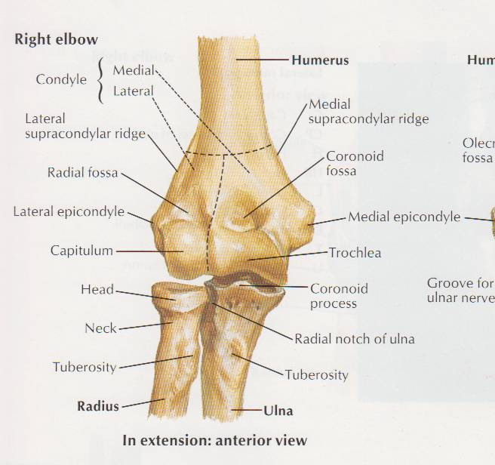
type of joint
- synovial joint
- hinge variety
- compound
- typical

Slide 4
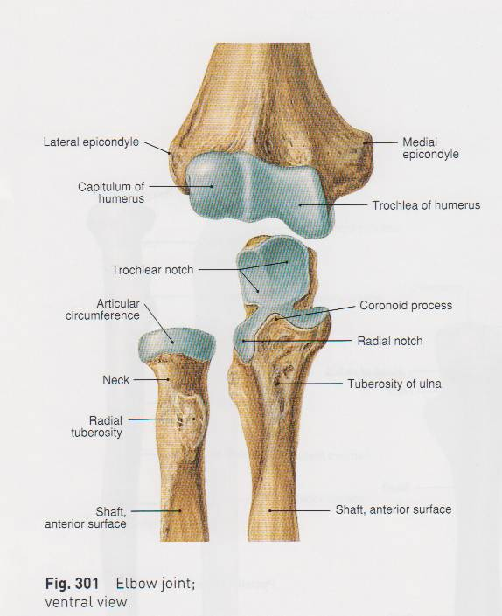
Articular surfaces
Capitulum and trochlea of the lower end of humerus
Upper surface of head of radius and trochlear notch of ulna

Slide 5
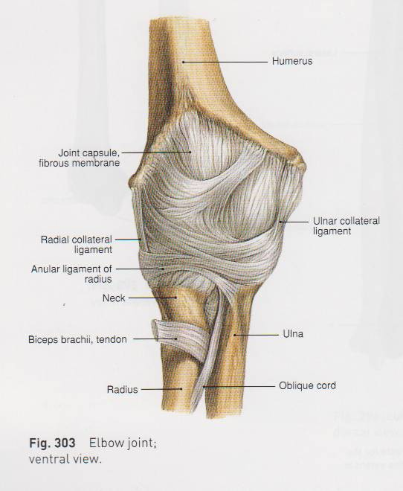
Ligaments

Slide 6
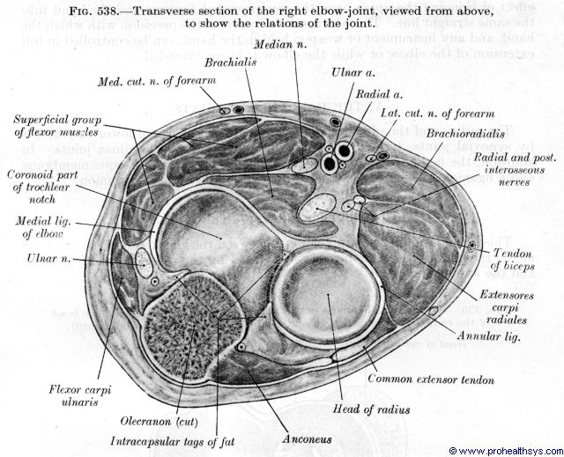
relations

Slide 7
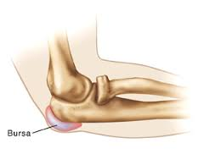
Bursae related to elbow joint
Subtendinous olecranon bursa
Subcutaneous olecranon bursa
Bicipitoradial bursa
Bursa separating biceps tendon from oblique cord

Slide 8
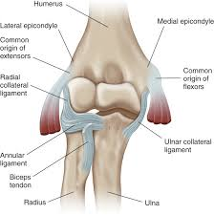
Stability of elbow joint
Trochlea of humerus fits into trochlear notch of ulna
Ulnar collateral ligament
Radial collateral ligament

Slide 9
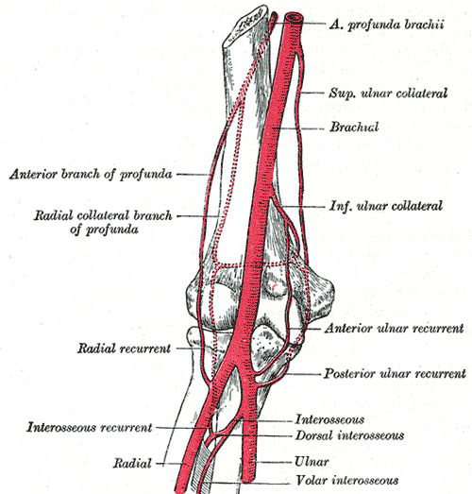
Blood supply
Anastomosis around elbow joint
-brachial artery
-radial artery
-ulnar artery

Slide 10
Nerve supply
Articular branches from
- radial nerve
- musculocutaneous nerve
- ulnar nerve
- median nerve

Slide 11
Carrying angle

Slide 12
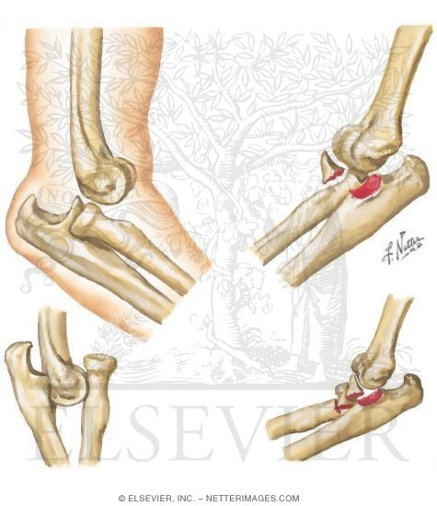
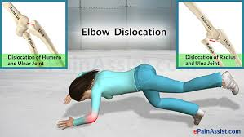
applied
Posterior dislocation of elbow

Slide 13
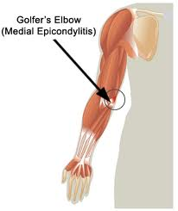
GOLFER’S ELBOW (Medial epicondylitis)

Slide 14
Tennis elbow
(Lateral epicondylitis)

Slide 15
Pulled elbow

Slide 16
Student’s elbow

Slide 17
Distension (effusion)of elbow joint

Slide 18
Nerve entrapment
- median nerve
- ulnar nerve
-posterior interosseous nerve

Slide 19
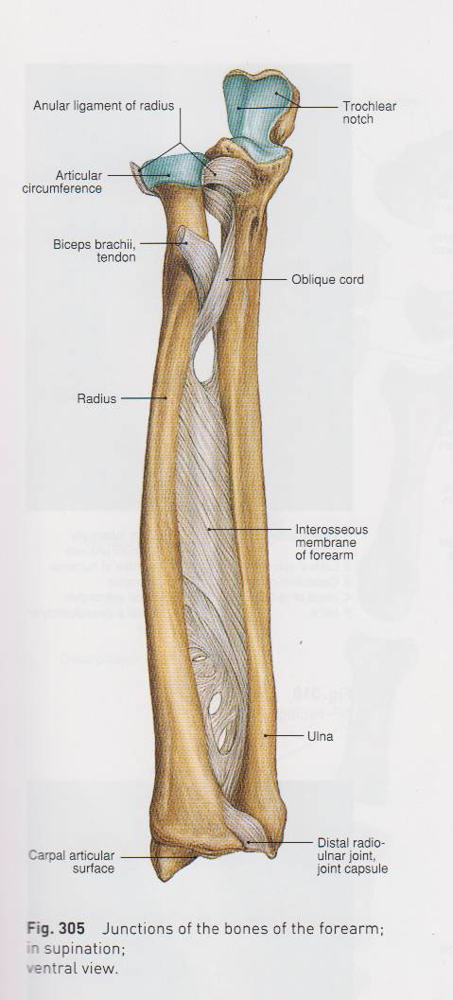
Radio ulnar joints
Superior radioulnar joint
Middle (interosseous) radioulnar joint
Inferior radioulnar joint

Slide 20
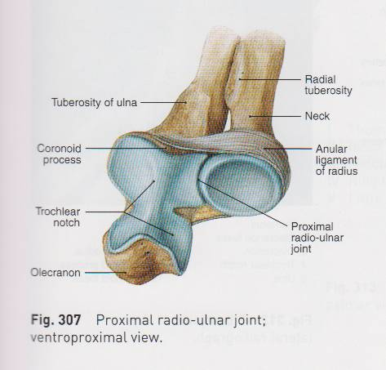
Articular surfaces
Circumference of radial head
Fibro-osseous ring made by radial notch of ulna and annular ligaments

Slide 22
Blood supply

Slide 23
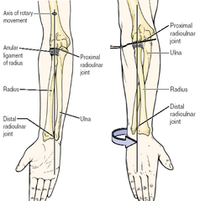
Supination and pronation

Slide 24
Muscles producing supination and pronation
Supination -supinator
biceps brachii
brachioradialis
Pronation -pronator teres
pronator quadratus
brachioradialis

Slide 25
multiple Choice questions
Flexors of elbow joint are
a)Biceps
b) Brachialis
c) Brachioradialis
d) All of the above

Slide 26
2) Elbow joint is a type of
Hinge joint
Pivot joint
Condylar joint
Ellipsoid joint

Slide 27
3) Inferior radioulnar joint is a type of
Hinge joint
Pivot joint
Condylar joint
Ellipsoid joint

Slide 28
4) Olecrenon bursitis is also called as
Golfer’s elbow
Student’s elbow
Tennis elbow
Pulled elbow elbow

Slide 29
5) The triangular relationship between the olecranon and the epicondyles of humerus is lost in
Supracondylar fracture of humerus
Student’s elbow
Synovitis of elbow
Posterior dislocation of elbow

Slide 30
Thank you

